Slide 1
Coronavirus Communication Plan Guidance
We have produced this coronavirus communication plan to assist people we support and those who love and care about them to stay in touch.
Please can this plan be completed for each person who requires support to stay in touch with their friends and family.
This plan is for the duration of COVID-19 only, it does not replace the accessible information communication profile document or other communication plans which people we support may have in place. In fact, the content of these other communication documents may assist when completing the coronavirus communication plan.
Wherever possible, these plans should be completed together with people we support. If this is not possible and if appropriate to do so, please contact people’s families in the presence of the person we support whenever possible in order to talk about how they would like to stay in touch and the frequency of any calls, e-mails or letters. Please remember to ask about other friends and family members during these calls.
Once completed, include information about these plans in the person’s communication support plan and / or shielding plan. Please also ensure a copy of the plan is uploaded into caresys or kept in the persons support / enabling plan file.
Please log any contact made with family members within people’s daily records within caresys or the paper based recording system in use.
Not being in touch with those we love and care about in the usual ways at this time is difficult for the people we support and their friends and family. Should a person we support contract confirmed or suspected COVID-19, please ensure contact with their family is maintained and recorded on a daily basis as a minimum.
Similarly, should we become aware that family members or friends of people we support are ill as a result of COVID-19 or any other illness, please ensure frequent contact is maintained to reassure the person we support.

Slide 2
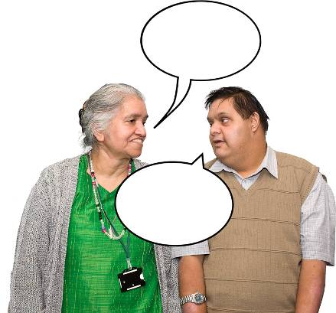
My Coronavirus communication plan
Write here…
My name is
Write here…
You can
call me
Add photo here…
This is me
This plan is to help me keep in touch with my family and friends during the Coronavirus.

Slide 3
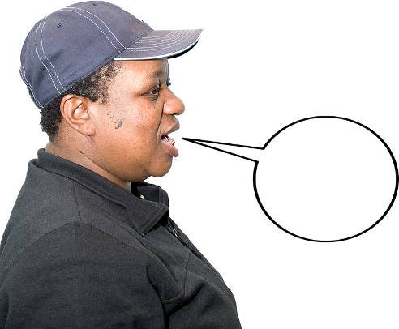
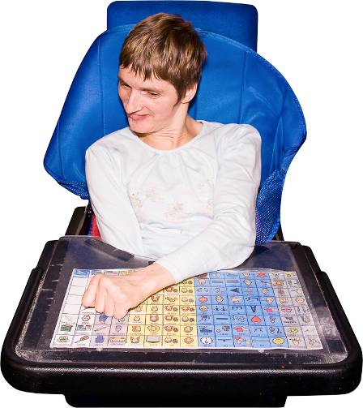
How I communicate
This is how I communicate
Write here…

Slide 4
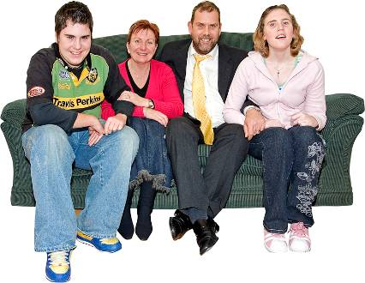
How I communicate
I would like you to help me communicate with:
Family (who and when):
Friends (who and when):
Other people (who and when):

Slide 5
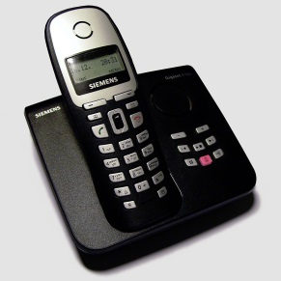
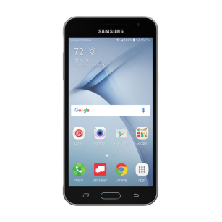
Communication/Contact
Telephone call
Text
Video call on a telephone
Recorded voice message
Whatsapp chat/call
Zoom/Skype call
Photographs
Email
Letters

Slide 6
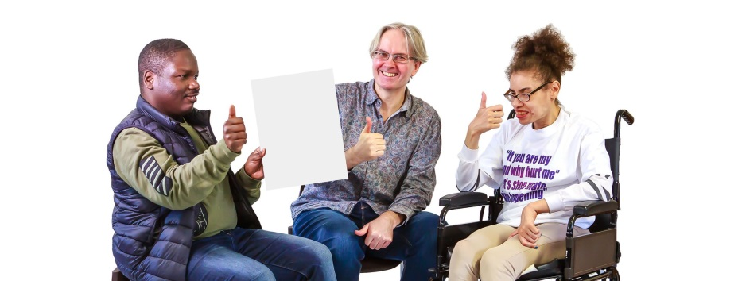
Communication/Contact
How can staff support me with this?
Write here…

Slide 7
Contact Sheet
When I make contact with my family, friends or anyone else, please keep a log.
Date
Who I contacted?
How I contacted them?
Write here…
Write here…
Write here…

Slide 8
Notes
Write here…

